Slide 1
Deep Learning for
Crop-Weed Classification
Using Computer Vision in Precision Agriculture
COMP3704 – Team 3

Slide 2
Introduction
Agricultural Challenges: Balancing productivity with sustainability.
Weed Management Importance: Traditional methods are labor-intensive and environmentally harmful.
Project Goal: Develop a deep learning model to distinguish crops from weeds using image-based data.
Key Benefits:
Reduce costs.
Improve crop yields.
Promote environmentally sustainable practices.

Slide 3
Table of contents
Problem Statement
Dataset Overview
Model Selection - Phase 1
Standardized Preprocessed Dataset
Experiments and Results
Challenges and Solutions
Real-Life Implementation
Conclusion

Slide 4
Problem Statement
Early-stage identification of crops vs. weeds is challenging due to similar morphological features.
Datasets often have imbalanced representations of certain weed species, affecting model performance.
Environmental factors like lighting and soil variability complicate accurate classification.

Slide 5
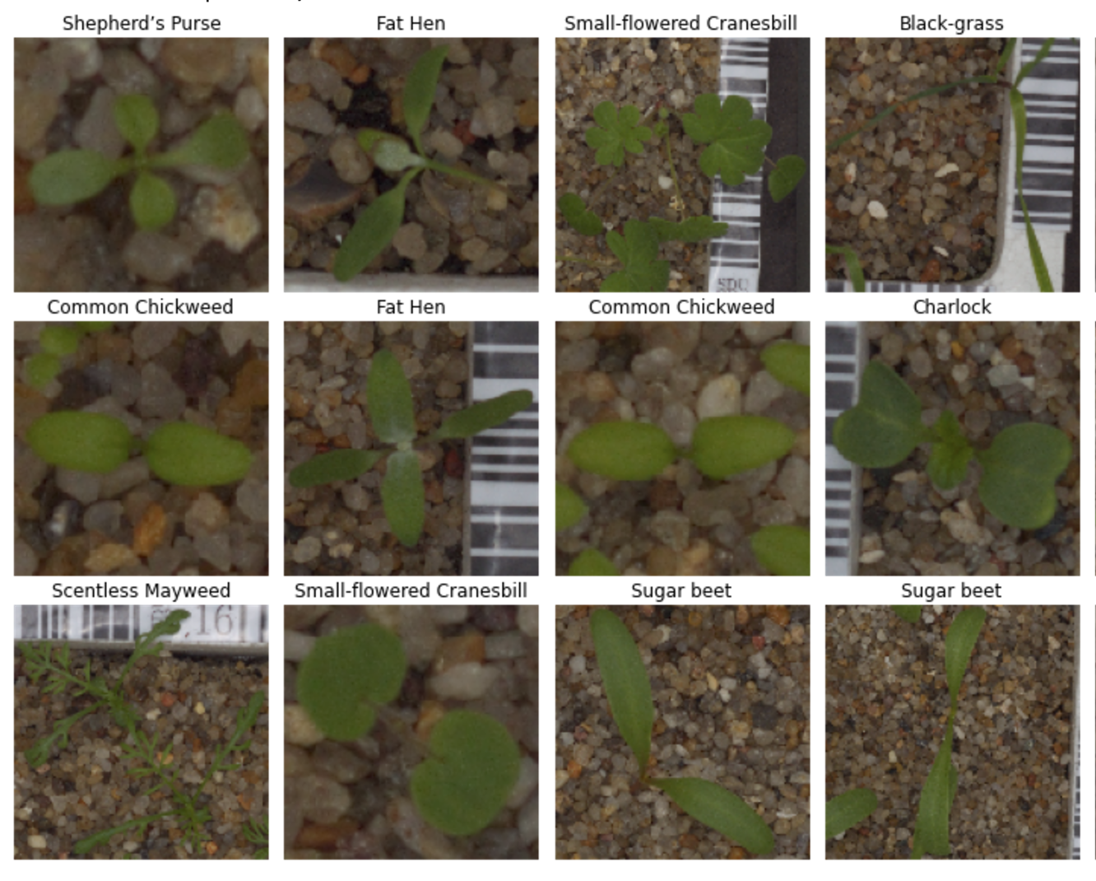
Dataset Overview
V2 Plant Seedlings Dataset - 960 images of 12 species. Images represent real farming conditions with variations in lighting and soil. Dataset selected for its relevance, species variety, and realistic conditions, reflecting real-world challenges.

Slide 6
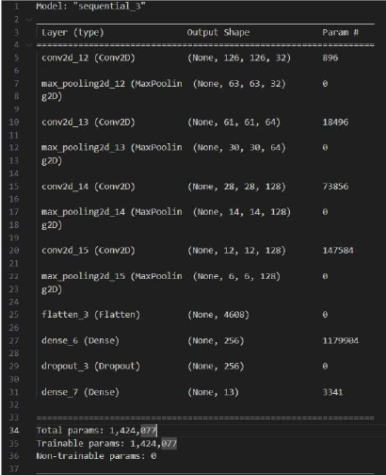
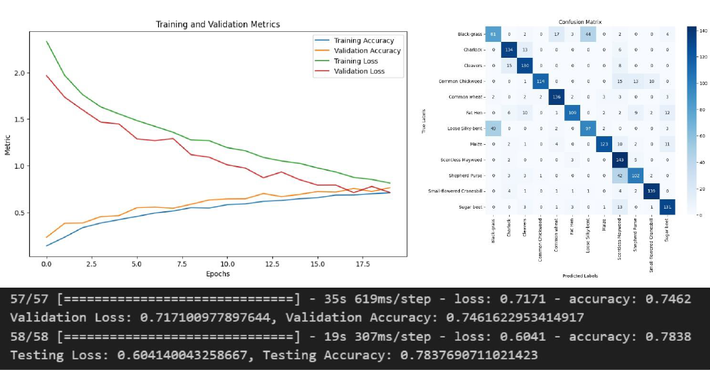
Model Selection - Phase 1

Slide 7
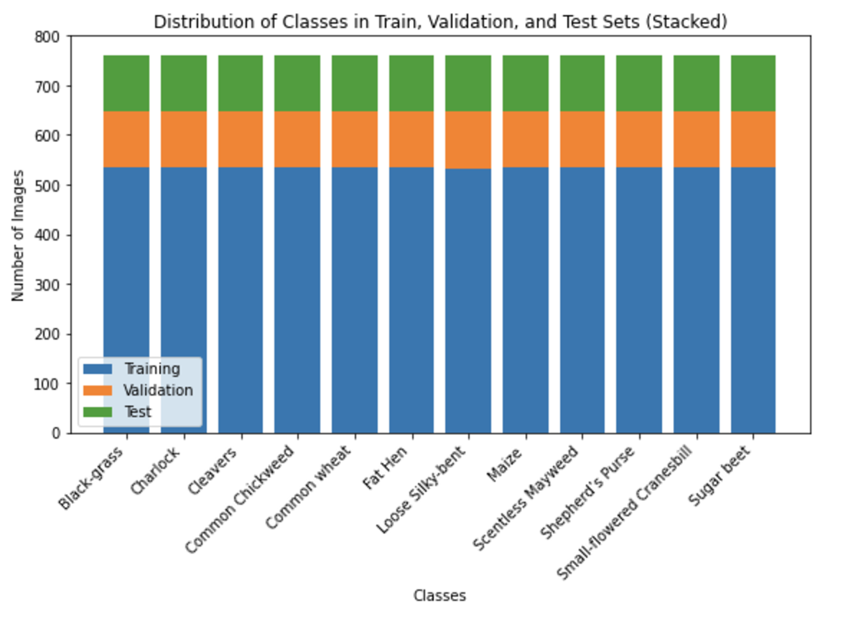
Standardized Dataset
Dataset was imbalanced
Used Keras ImageDataGenerator to augment the dataset

Slide 8
Model Selection - Phase 2
Focused on experimenting with VGG16 by varying configurations to enhance performance.
Compared versions based on testing accuracy, precision, recall, and efficiency. Selected two best-performing models for analysis and potential deployment.

Slide 9
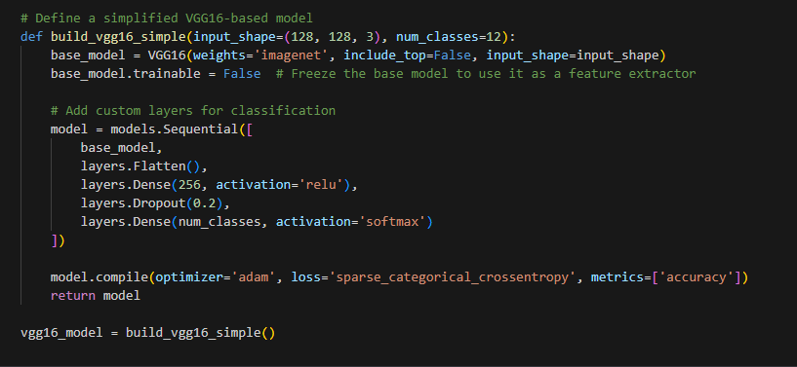
Using VGG16

Slide 10
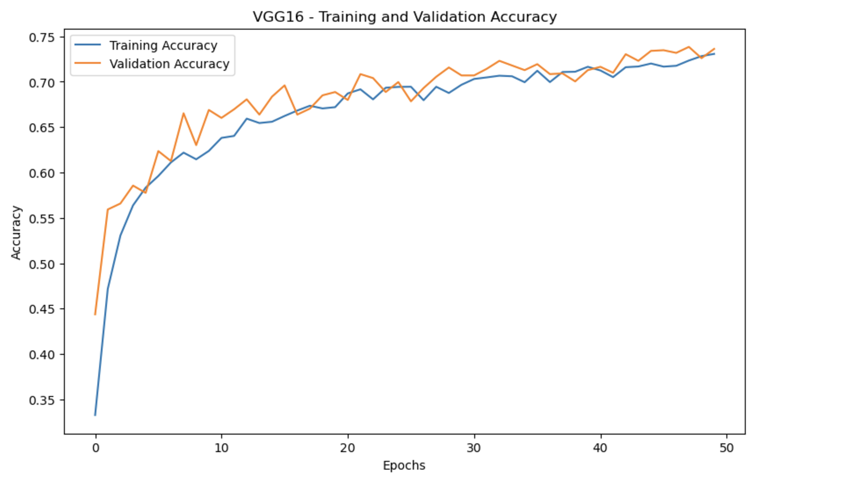
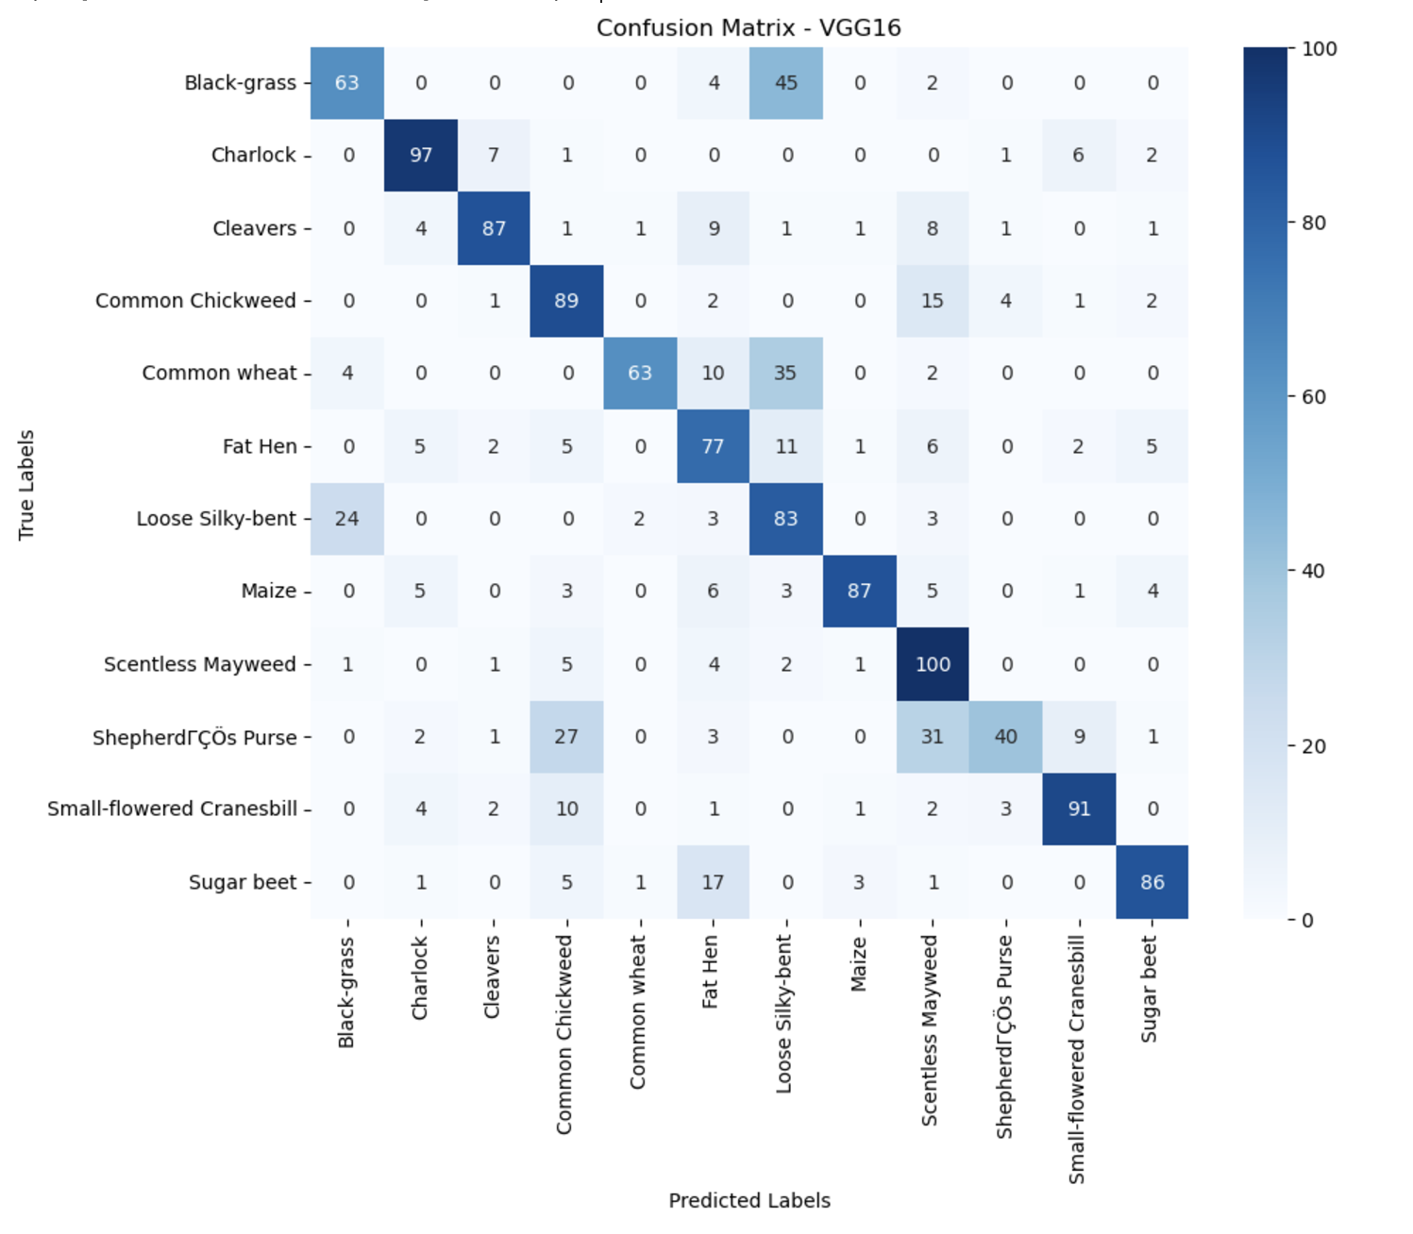
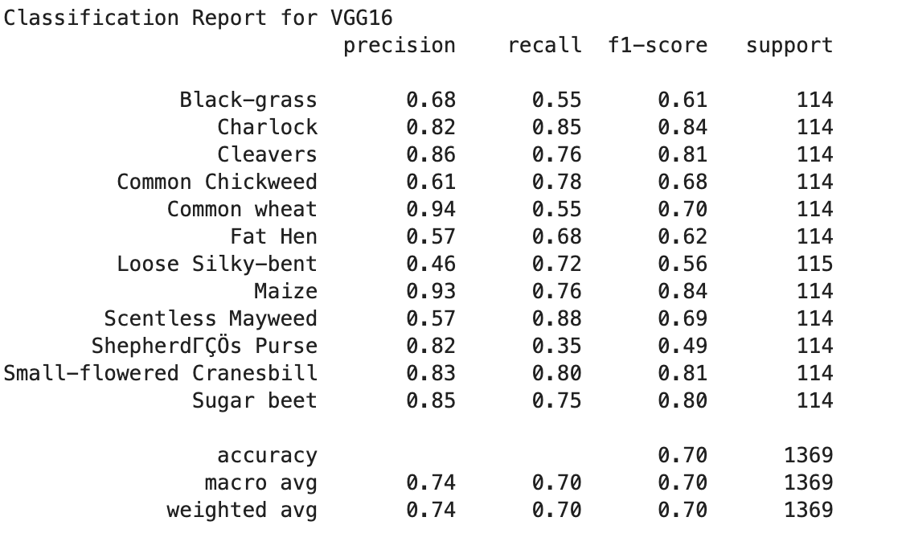
Using VGG16

Slide 11
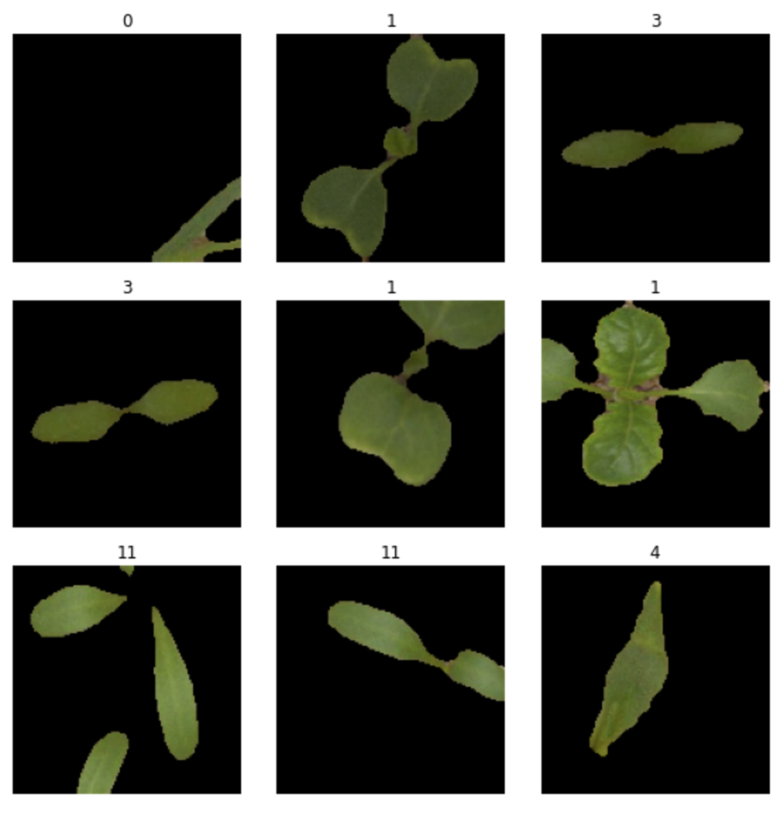
Image Segmentation
Separate objects of interest from the background
Distinguish relevant features from irrelevant noise in images

Slide 12
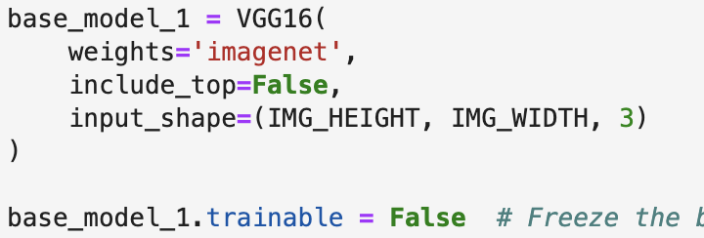
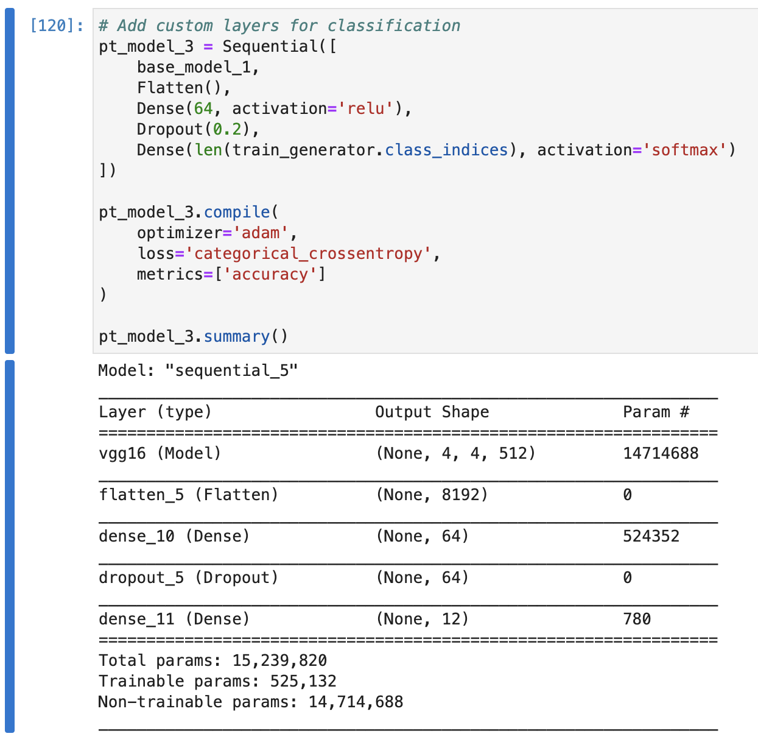
Using VGG16 (Segmented)

Slide 13
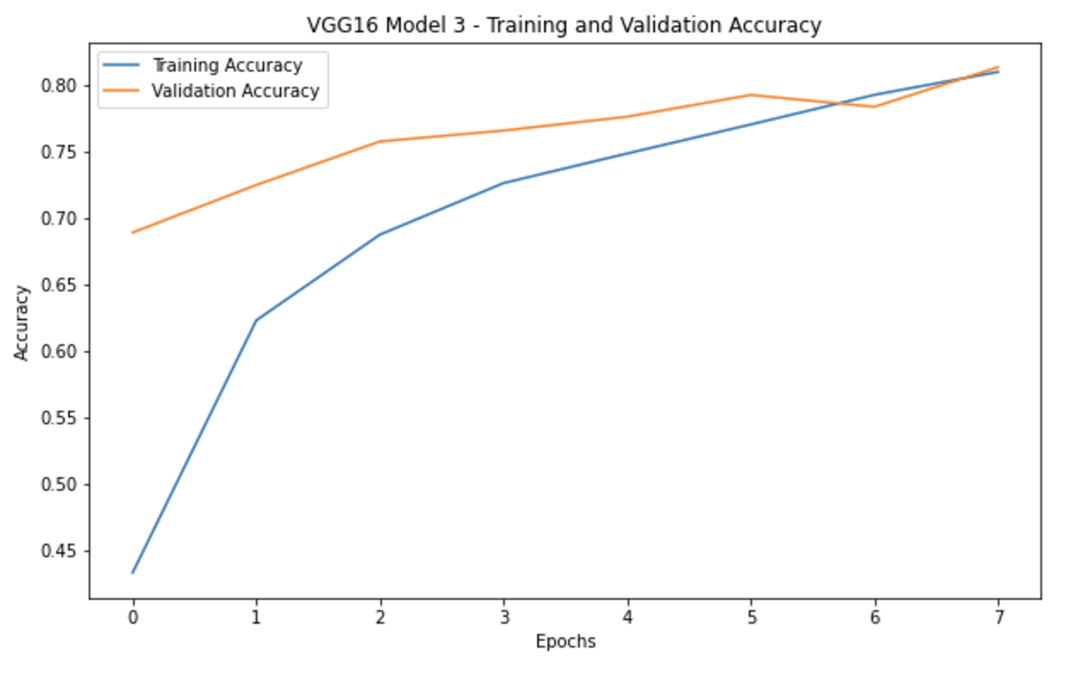
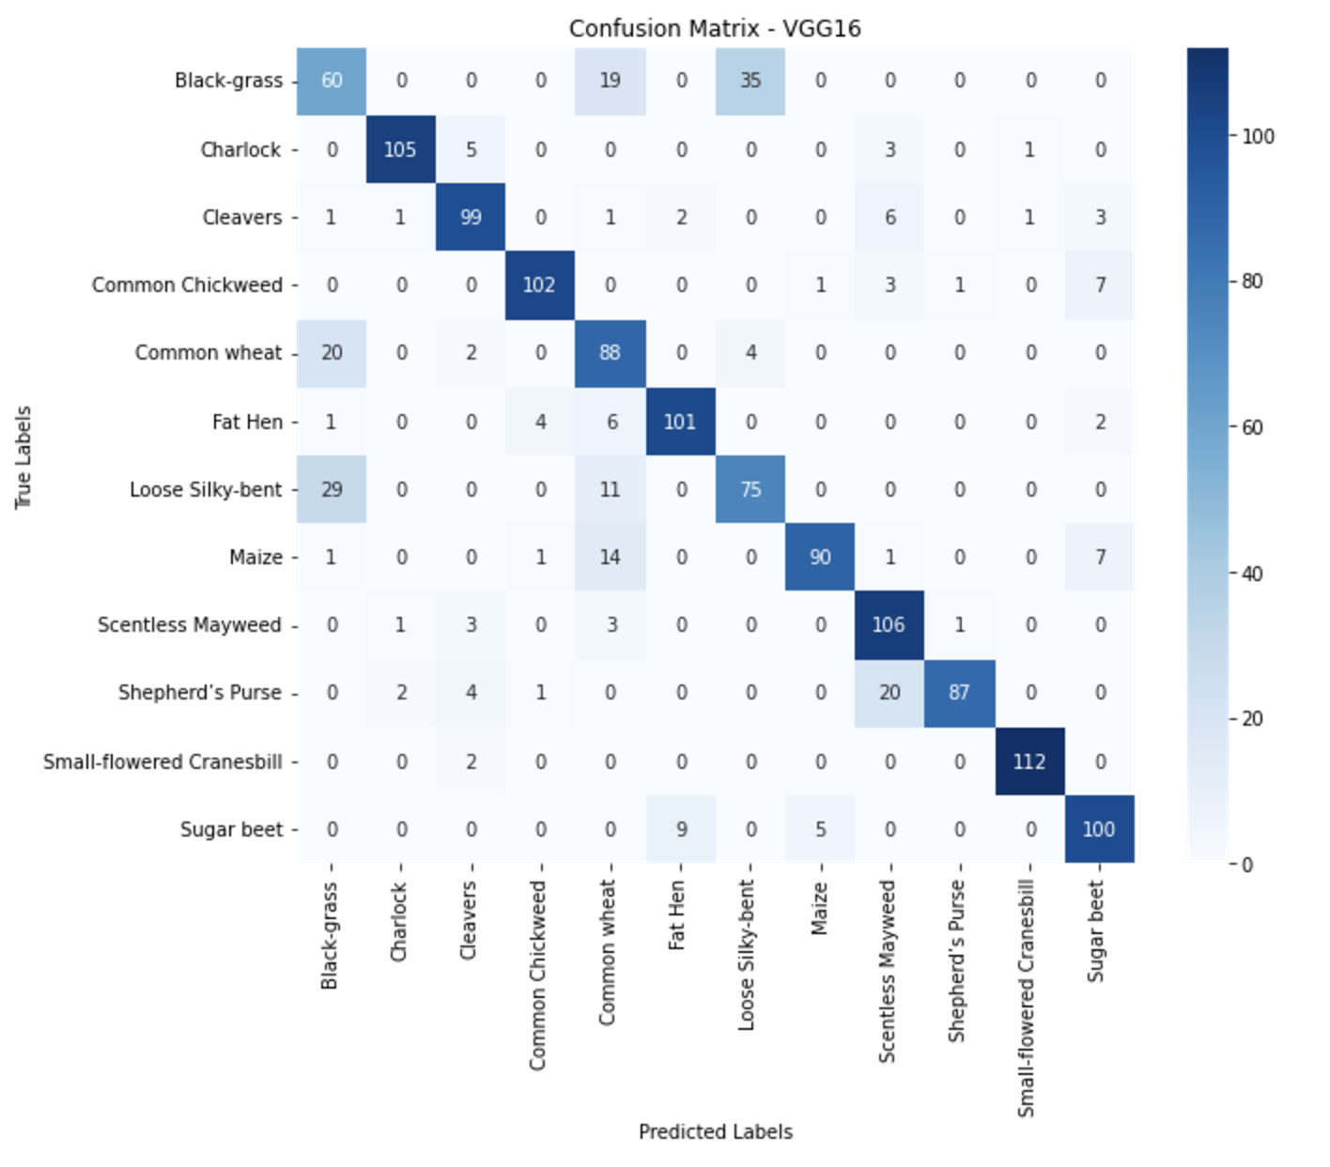
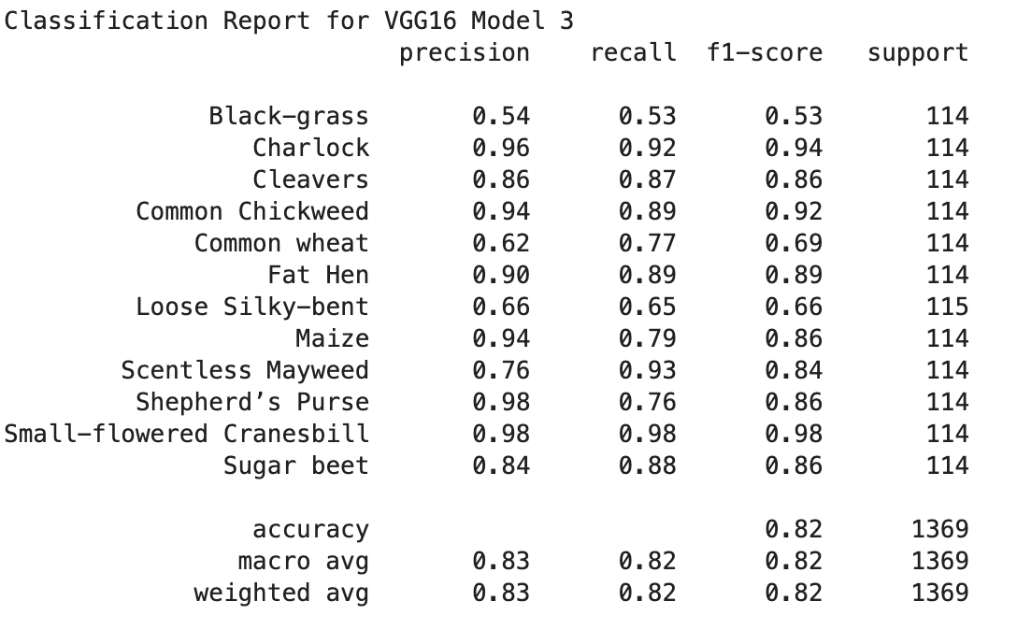
Using VGG16 (Segmented)

Slide 14
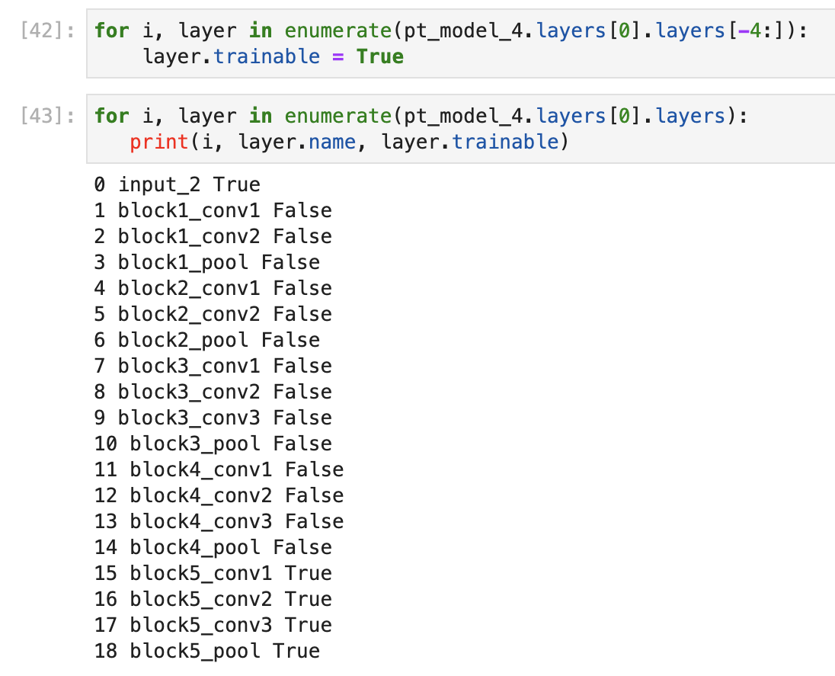
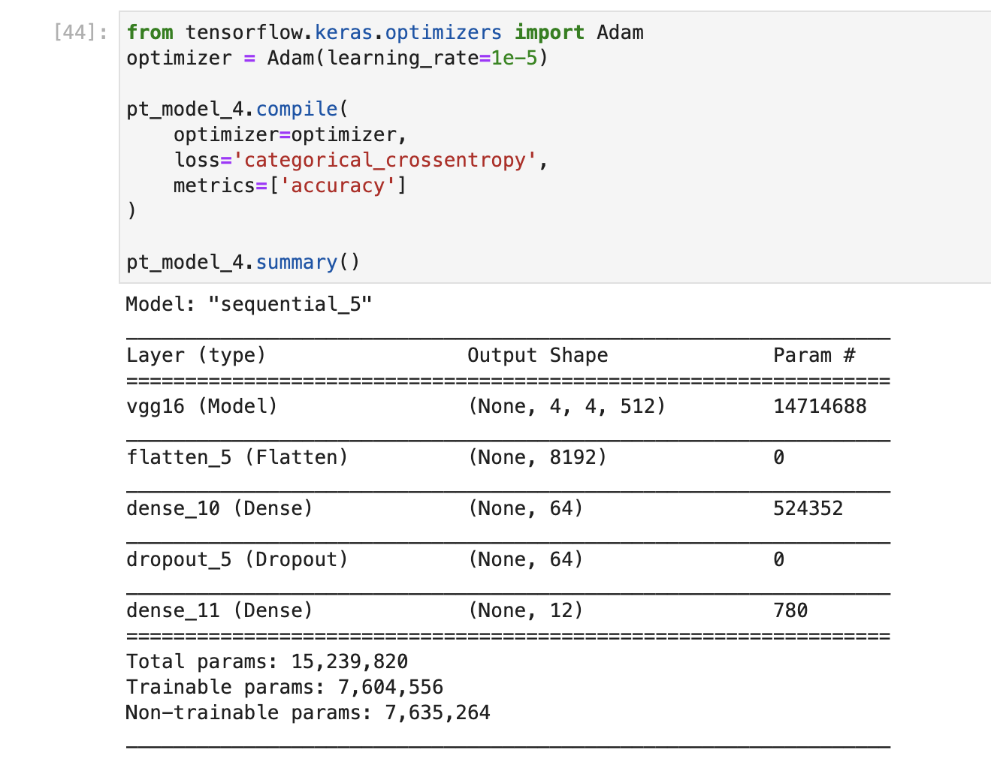
Performance Tuning
Used VGG16 and froze all layers except the last four
Reduced learning rate from default 0.001 to 0.00001
Note: Don’t forget to compile the model

Slide 15
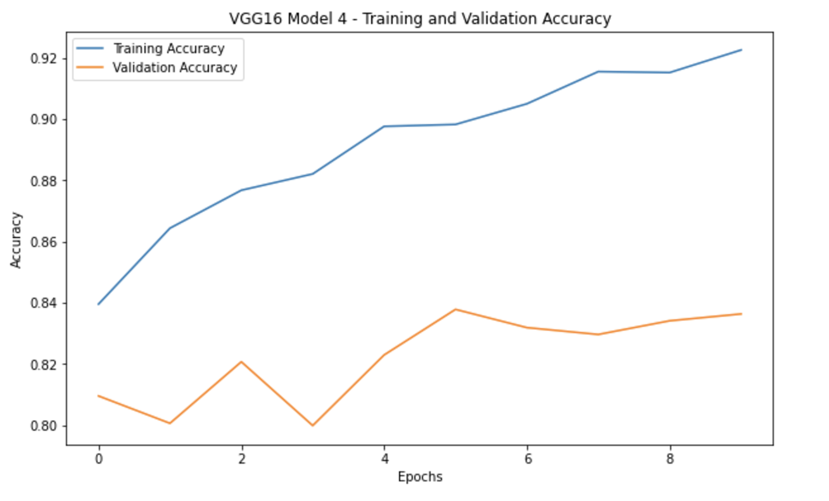
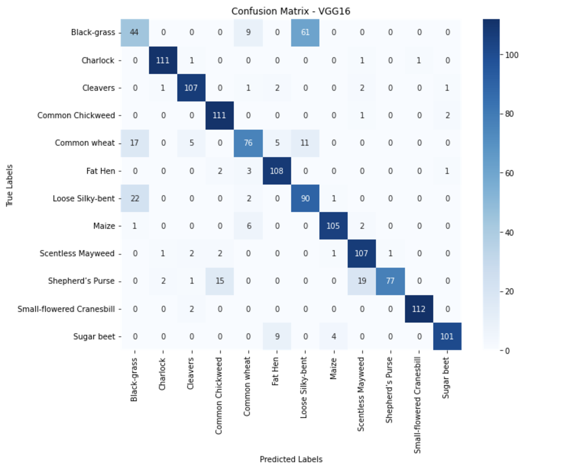
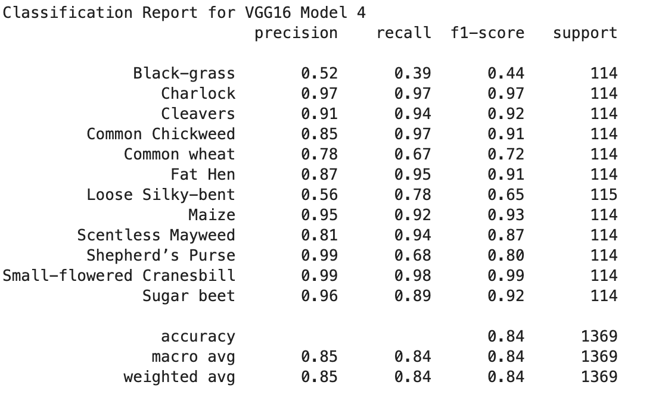
Fine-tuned Model

Slide 16
Challenges
Solutions
1. Imbalanced dataset
Data Augmentation
2. Inconsistent Preprocessing
Shared a dataset
3. Unexpected results with pre-trained models
More experimentation
Regularization, Early stopping, Freezing trainable layers.
4. Overfitting
5. Technical Limitation
Resource allocation

Slide 17
Real-Life Implementation
Improve performance by integrating real-time drone or robotic imaging systems.
Extend to multiclass segmentation for differentiating weed species.
Collaborate with agricultural experts for deployment in real-world scenarios.

Slide 18
Conclusion & Demo
Automated Weed and Crop Segmentation: The project demonstrated the effectiveness of deep learning models for automated weed and crop segmentation, offering a scalable solution for precision agriculture
Improved Efficiency: By leveraging advanced image segmentation techniques, the model enables faster, more accurate identification of weeds and crops, reducing the need for manual labor and minimizing the risk of herbicide overuse
Environmental and Economic Benefits: This approach supports sustainable farming practices, enhances crop yield, and cuts costs related to herbicide application and labor.
Future Potential: With further refinement and real-time integration, this technology can revolutionize weed management in agriculture, making it more precise, cost-effective, and environmentally friendly.

Slide 19
Thank you!
Do you have any questions?

Slide 20
References
Kaggle. (n.d.). V2 Plant Seedlings Dataset. Retrieved from https://www.kaggle.com/c/plant-seedlings-classification/data
Gupta, K., Rani, R., & Bahia, N. K. (n.d.). Plant-seedling classification using transfer learning-based deep convolutional neural networks. Deloitte Consulting India Pvt. Ltd., Hyderabad, India, & Department of Computer Science and Engineering, NIT Jalandhar Punjab, India. Retrieved from https://orcid.org/0000-0003-2104-227X
Srinivasan, A. (2006). Precision agriculture: An overview. In A. Srinivasan (Ed.), Handbook of precision agriculture: Principles and applications (pp. 1-18). The Haworth Press.

